Slide 1
Predicting Taxi Ride Prices
Sven Durchholz
Leonard Schmischke

Slide 2
Why Data Science?
“The demand for data scientists is increasing so quickly, that McKinsey predicts that by 2018, there will be a 50 percent gap in the supply of data scientists versus demand.” – The Alexa Blog (http://blog.alexa.com/know-data-science-important/)

Slide 3
What is the data about?
Rides of Yellow Cabs (taxis) in New York
June 2016
~11 million rides
19 features
geolocation, time and date, distance, fares, …
5 missing features in test data set
Fare_amount
Extra
MTA
Tip_amount
Total_amount

Slide 4
What is the data about?
Six rate codes:
Standard metered fare
$2.5 initial charge
When faster than 6mph: 50ct per 0.2 mile
When slower than 6mph: 50ct per minute
50ct overnight surcharge (8pm to 6am), $1 rushhour surcharge (4pm to 8pm on weekdays)
Extra charges: 30ct improvement surcharge, up to 50ct MTA surcharge, tolls
Tips when paying with credit card (payment_type 2)
http://www.nyc.gov/html/tlc/html/passenger/taxicab_rate.shtml

Slide 5
What is the data about?
Six rate codes:
Standard metered fare
Trips to/from JFK Airport
$52 flat
$4.5 rush-hour surcharge (4pm to 8pm on weekdays)
Extra charges: 30ct improvement surcharge, up to 50ct MTA surcharge, tolls
http://www.nyc.gov/html/tlc/html/passenger/taxicab_rate.shtml

Slide 6
What is the data about?
Six rate codes:
Standard metered fare
Trips to/from JFK Airport
Trips to Newark Airport
Uses standard metered fare (everything from 1 applies)
$17.50 Newark Surcharge
http://www.nyc.gov/html/tlc/html/passenger/taxicab_rate.shtml

Slide 7
What is the data about?
Six rate codes:
Standard metered fare
Trips to/from JFK Airport
Trips to Newark Airport
Out of Town Trips (to/from Manhattan from/to Westchester & Nassau Counties)
In town: standard metered fare (see 1)
Out of town: doubled standard metered fare
All charges apply
http://www.nyc.gov/html/tlc/html/passenger/taxicab_rate.shtml

Slide 8
What is the data about?
Six rate codes:
Standard metered fare
Trips to/from JFK Airport
Trips to Newark Airport
Out of Town Trips (to/from Manhattan from/to Westchester & Nassau Counties)
Negotiated Trips (everywhere else)
Flat rate is negotiated before the ride
50ct MTA and 30ct improvement surcharge apply
http://www.nyc.gov/html/tlc/html/passenger/taxicab_rate.shtml

Slide 9
What is the data about?
Six rate codes:
Standard metered fare
Trips to/from JFK Airport
Trips to Newark Airport
Out of Town Trips (to/from Manhattan from/to Westchester & Nassau Counties)
Negotiated Trips (everywhere else)
Group rides
Two possible routes with specific pickup and dropoff locations
Flat price per person
http://www.nyc.gov/html/tlc/html/passenger/taxicab_rate.shtml

Slide 10
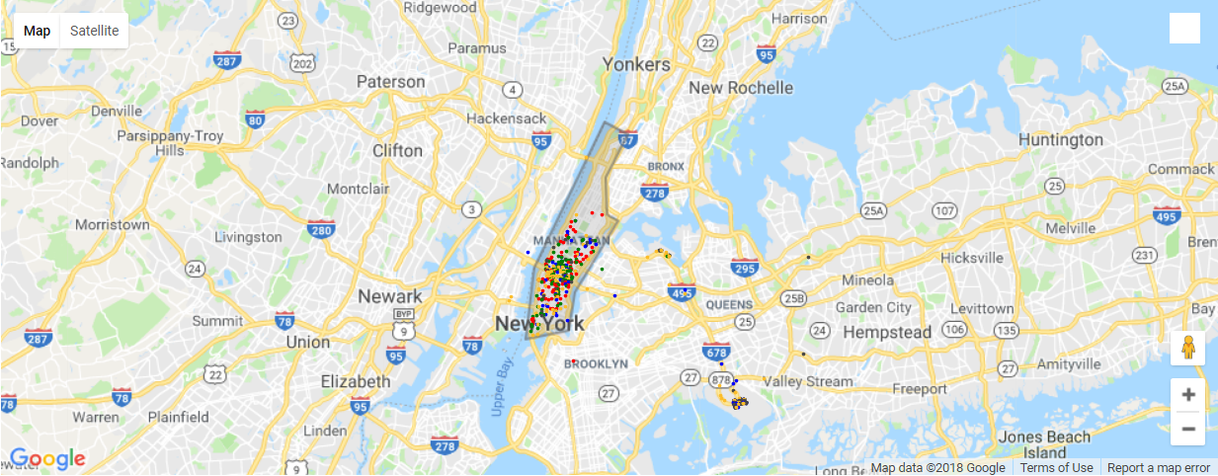
Pickup-locations per ratecode
Standard Rate (1)
JFK (2)
Newark (3)
Out of Town (4)
Negotiated (5)

Slide 11
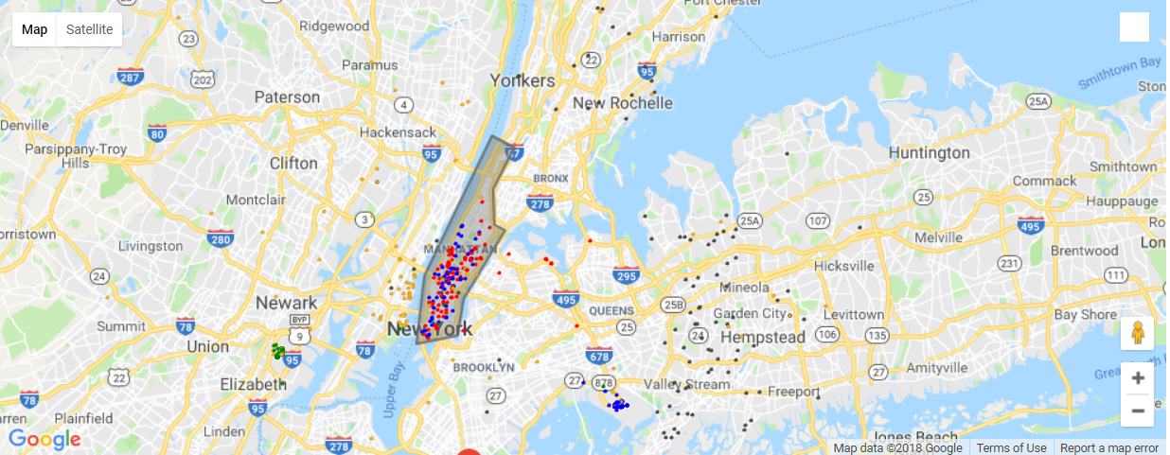
Dropoff-locations per ratecode
Standard Rate (1)
JFK (2)
Newark (3)
Out of Town (4)
Negotiated (5)

Slide 12
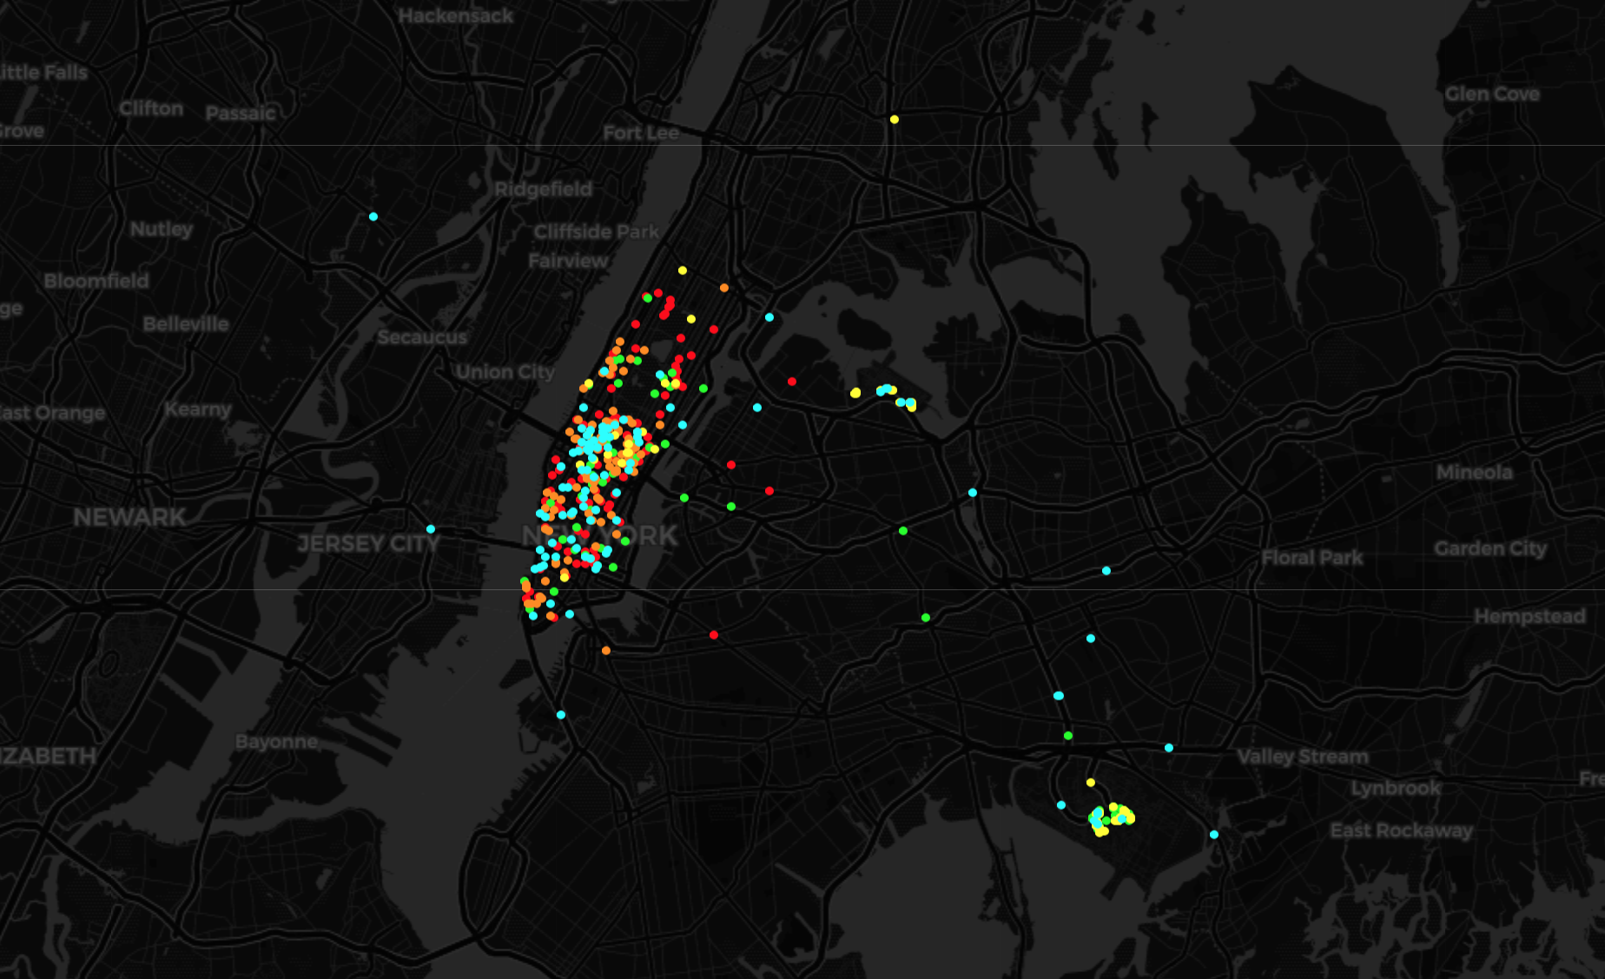
Pickup-locations per ratecode
Standard Rate (1)
JFK (2)
Newark (3)
Out of Town (4)
Negotiated (5)

Slide 13
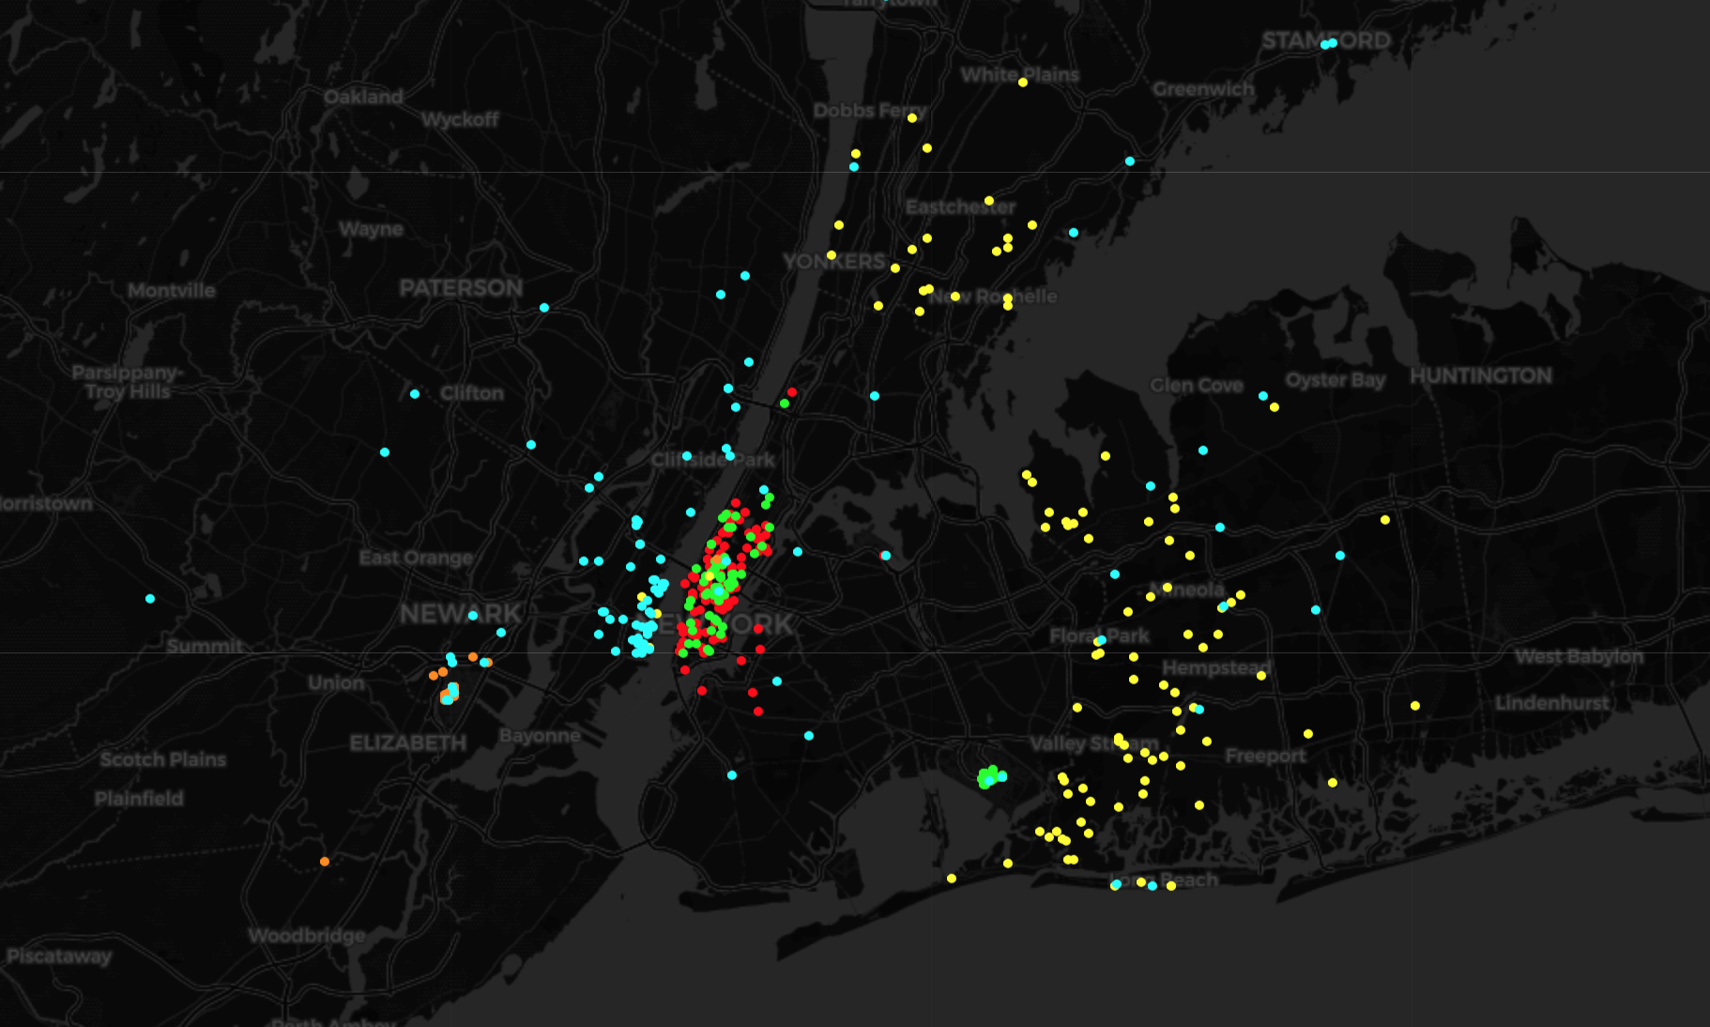
Dropoff-locations per ratecode
Standard Rate (1)
JFK (2)
Newark (3)
Out of Town (4)
Negotiated (5)

Slide 14
EDA

Slide 15
Outlier detection
Invalid values
RatecodeIDs
Improvement surcharge
MTA tax (either 0 or .5)
Extra
Date
Negative Values
Total amount must be sum of all other costs
Create new features for better analysis

Slide 16
Outlier detection
Drop unreasonable high values
Distance > 100 miles
Fare amount > $400
Get tip percentage
Drop > 50%
Get duration
Drop < 30 seconds
Drop > 3 hours
Drop Dates outside June 2016

Slide 17
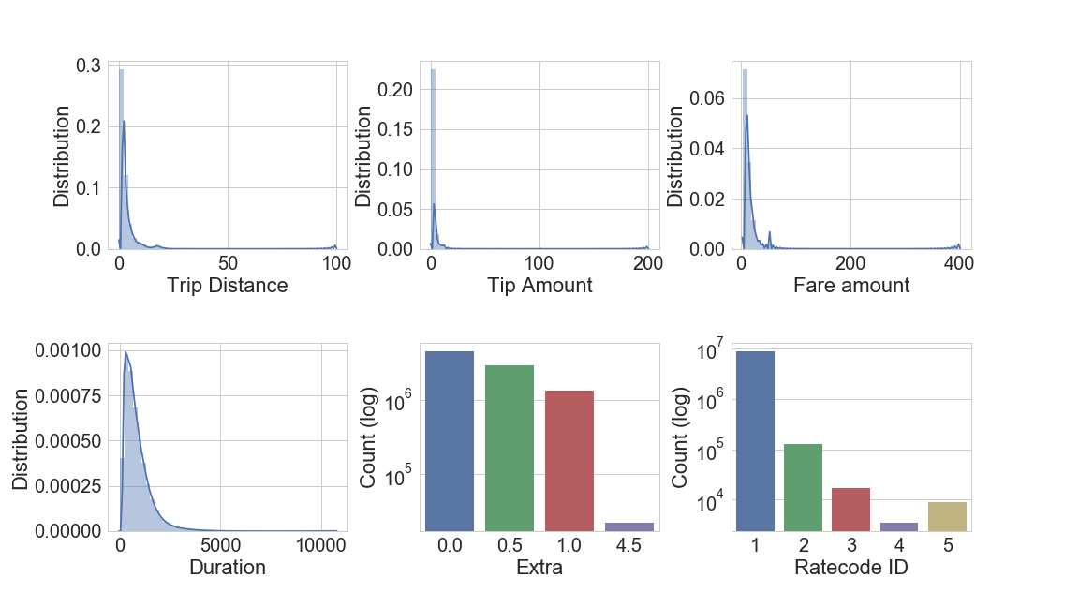
Outlier detection

Slide 18
Outlier detection

Slide 19
Outlier detection

Slide 20
Outlier detection
New features?
Avg_speed
Traffic per hour (only if important)
What did not work?

Slide 21
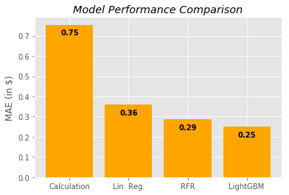
Fare amount prediction

Slide 22
Fare amount prediction
Trip_distance
duration
ridesAtPickupHour
Pickup_hour
Avg_speed

Slide 23
Modelling approach

Slide 24
Modelling approach

Slide 25
Modelling approach
Can be used for rate code 1 and 3
Rate code 2?
Rate code 5?
Rate code 4?

Slide 26
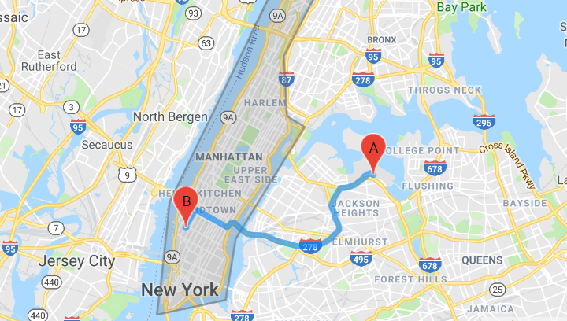
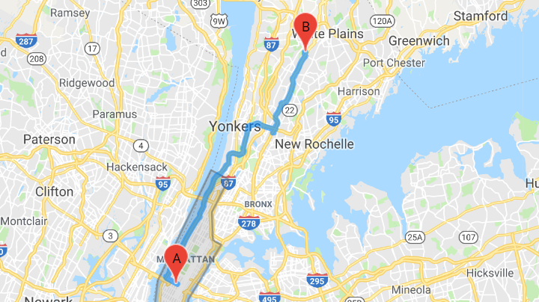
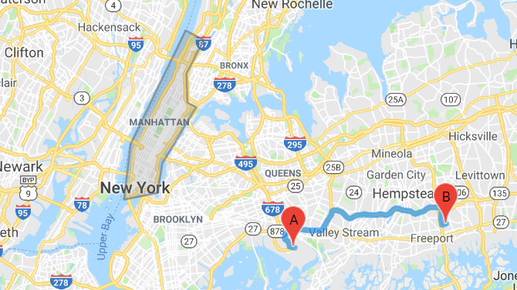
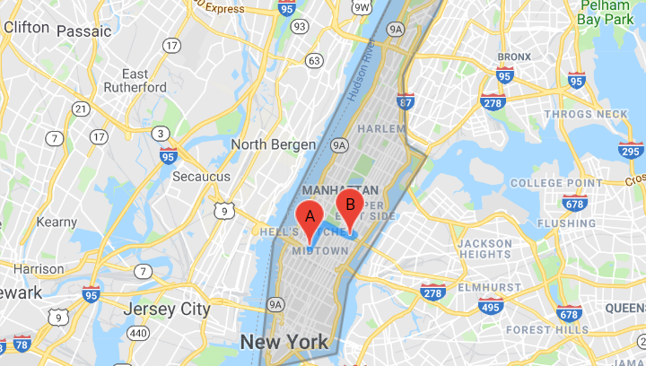
Rate code 4 – „Out of Town Trips“
Entering the city
Leaving the city
Only outside of the city
Only inside the city

Slide 27
Algorithm selection

Slide 28
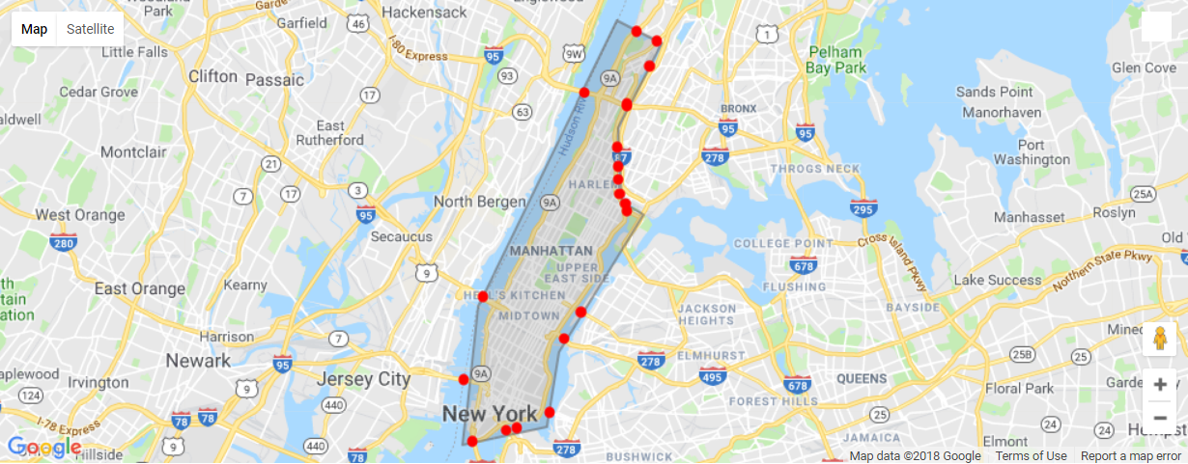
Bridge/tunnel positions

Slide 29
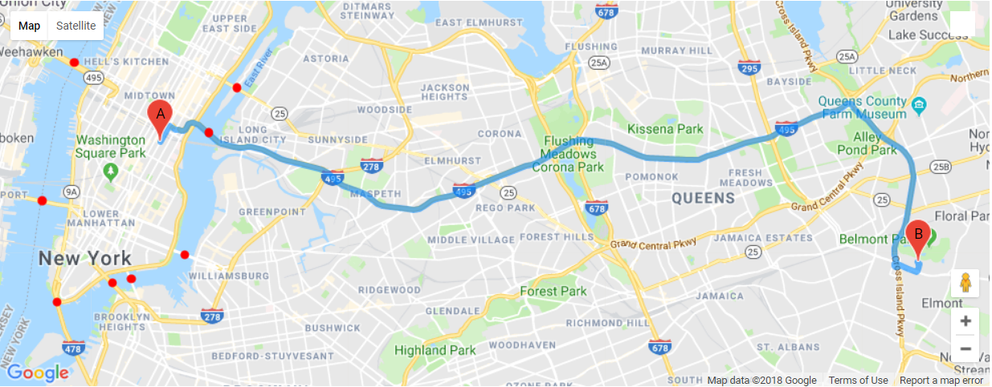
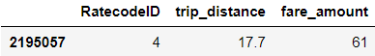
Bridge calculations (2195057)

Slide 30
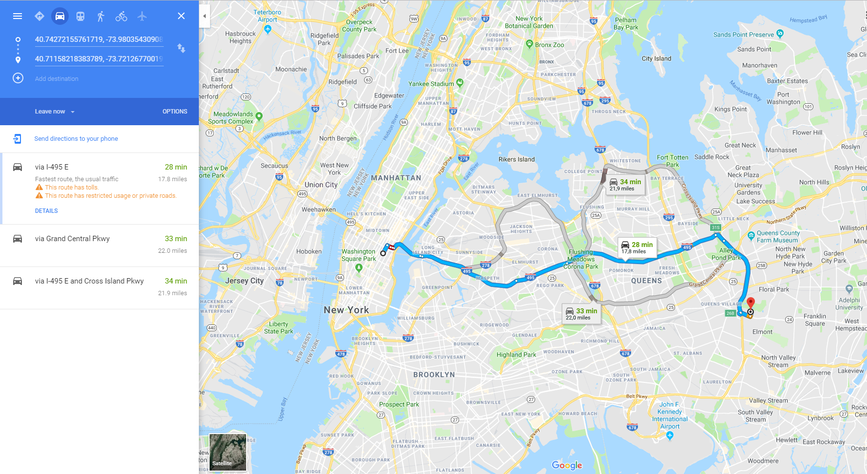
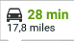
Bridge calculations (2195057)

Slide 31
Bridge calculations (2195057)
A
B
C

Slide 32
Bridge calculations (2195057)
A
B
C

Slide 33
Bridge calculations (2195057)
0.87 miles
12.9533 miles

Slide 34
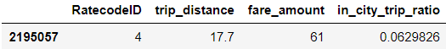
Bridge calculations (2195057)
0.87 miles
12.9533 miles

Slide 35
Bridge calculations (2195057)
0.87 miles
12.9533 miles

Slide 36
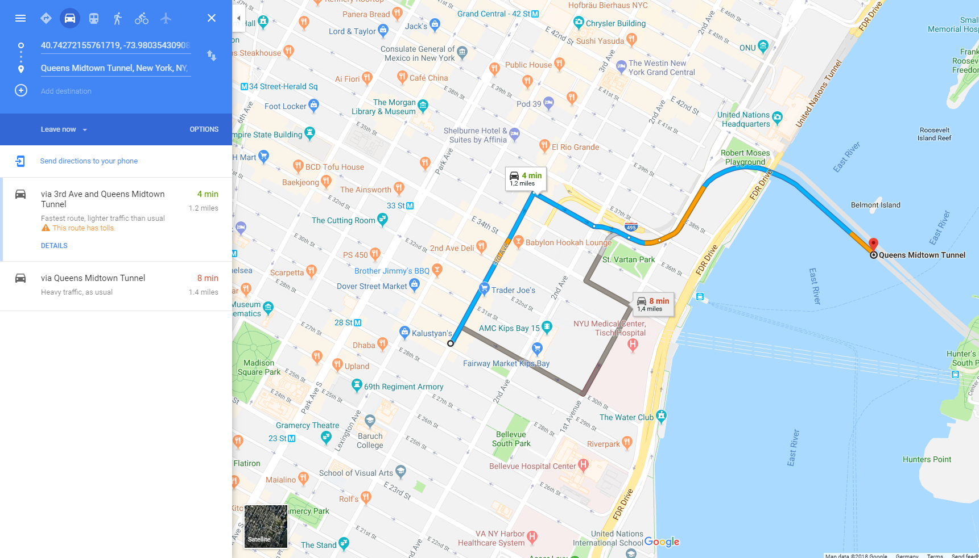
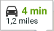
Bridge calculations (2195057)

Slide 37
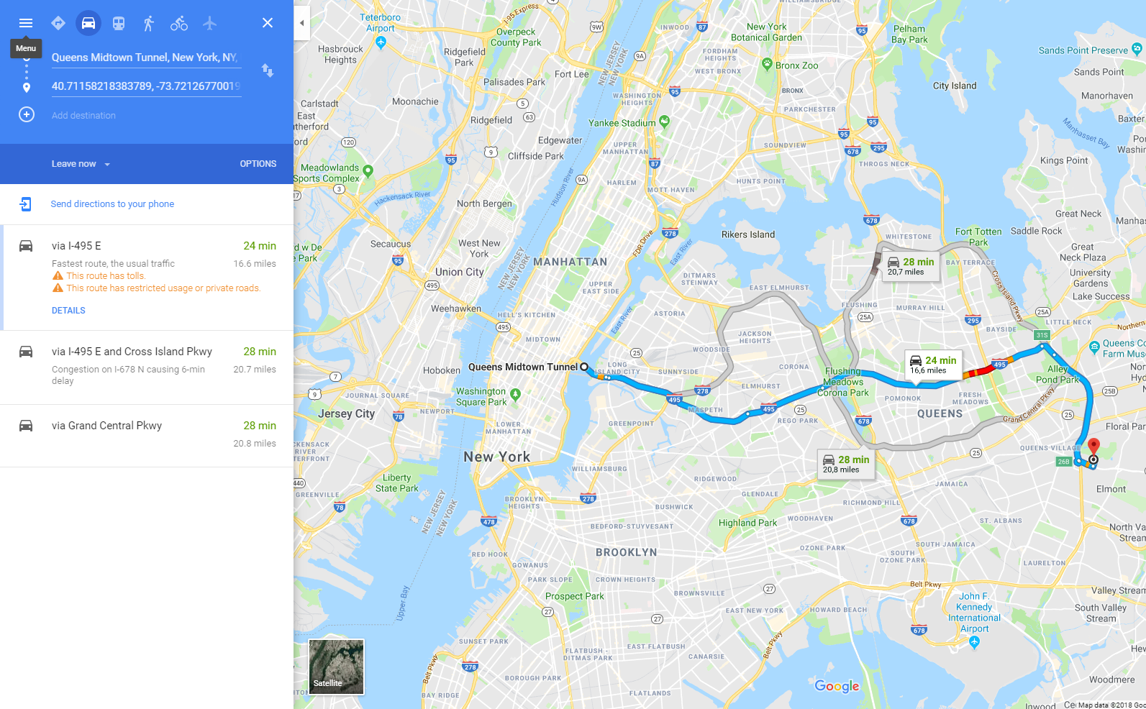
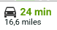
Bridge calculations (2195057)

Slide 38
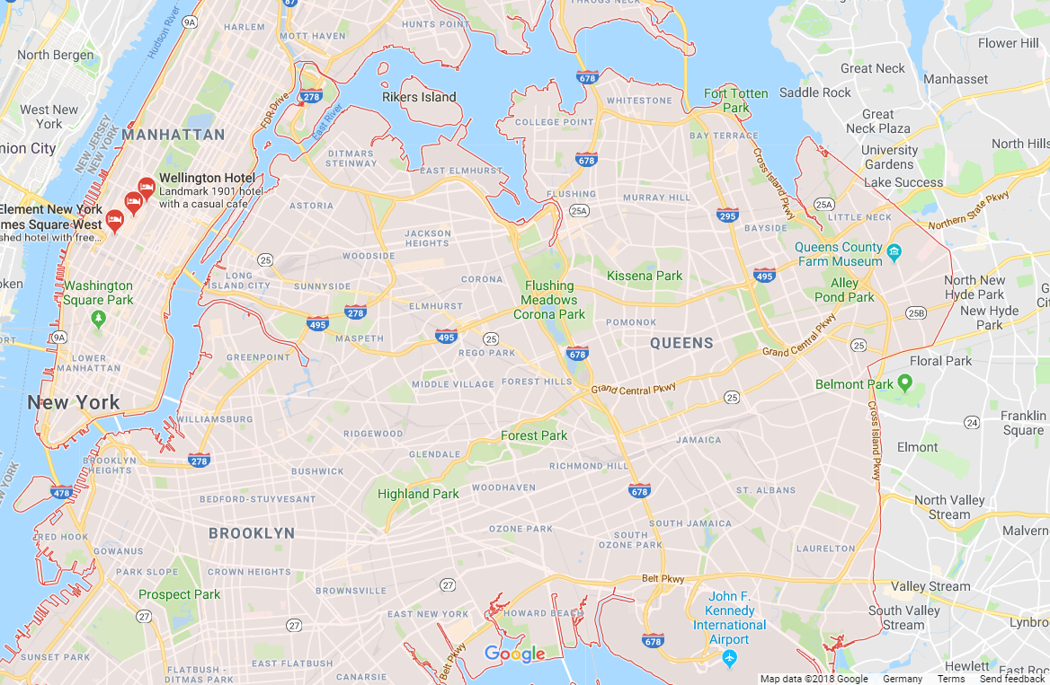
Bridge calculations (2195057)

Slide 39
Problems
Assumption 1: Bridge that minimize air-line distance is actually used
Different route
Non-linear route
Assumption 2: air-line distance ratio represents real inner-city to outer-city trip distance ratio
Different shape of route in city vs out of city
Extra destinations possible

Slide 40
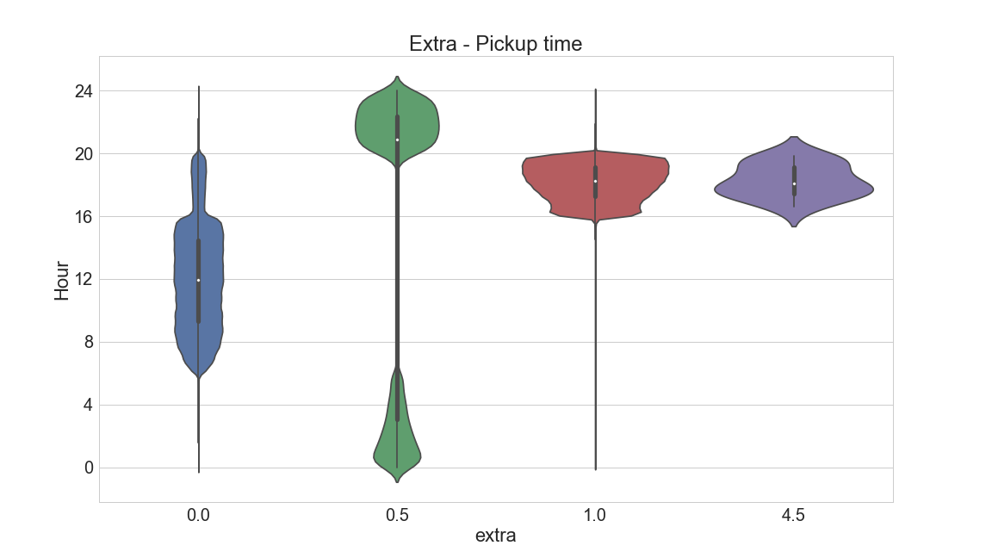
Extra Prediction
No Extra
Overnight
Rush Hour
Rush Hour JFK

Slide 41
Extra Prediction - Calculation
MAE:
0.006

Slide 42
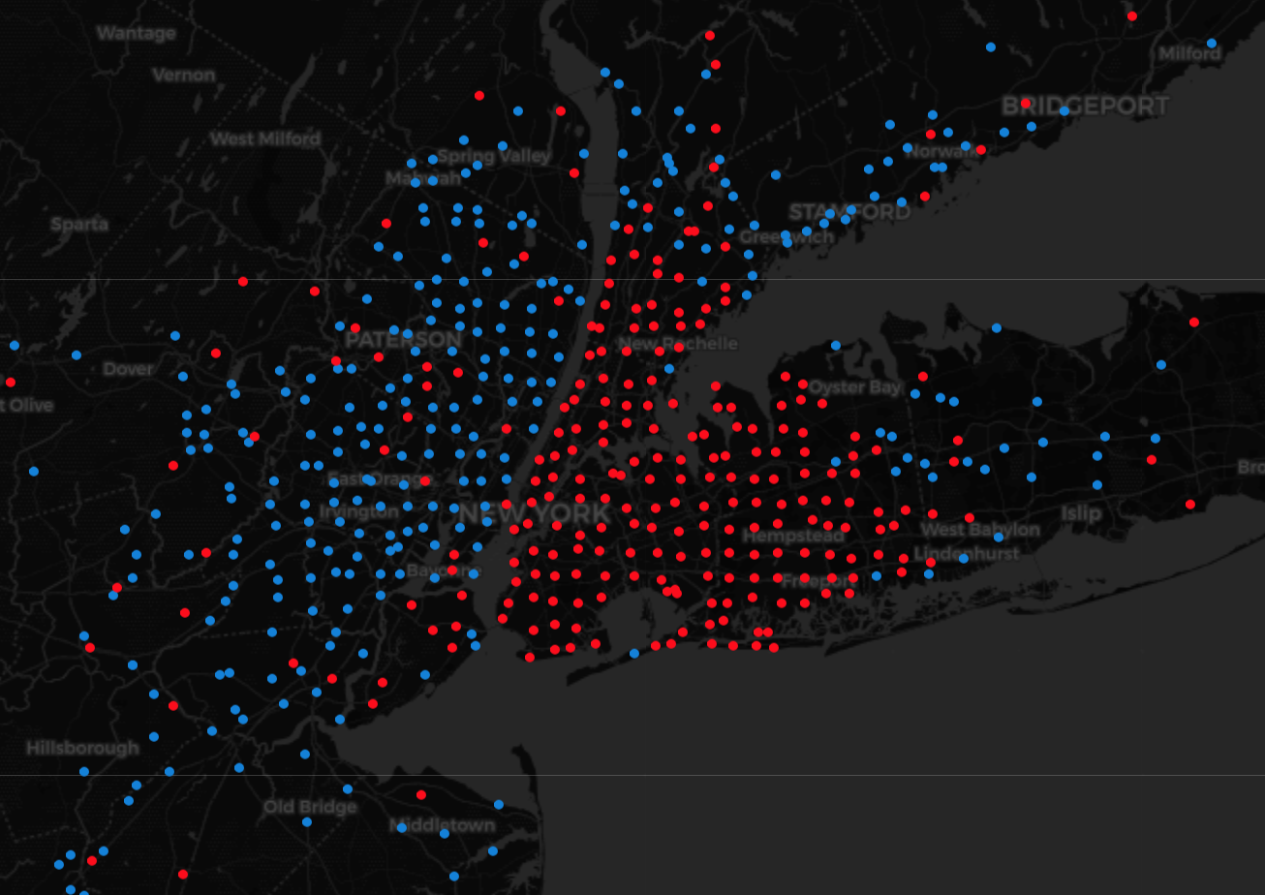
MTA Tax Prediction

Slide 43
MTA Tax Prediction
Ratecodes have homogeneous tax
SVM also assumes homogeneous tax
Alternative: Calculate dropoff polygons
=> insignificant error

Slide 44
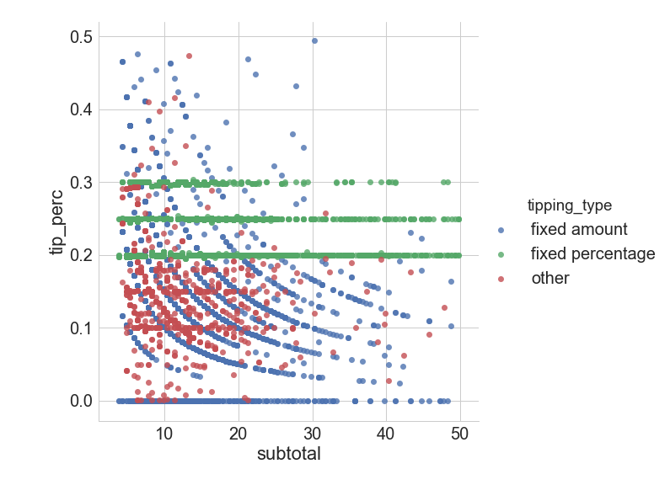
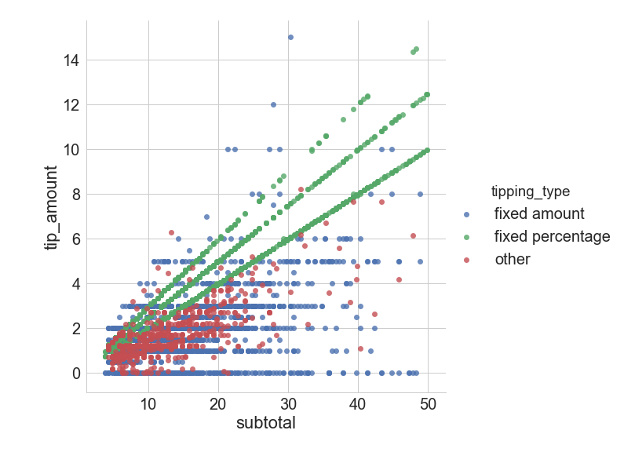
Tipping Behaviour
Tip percentage
Total tip

Slide 45
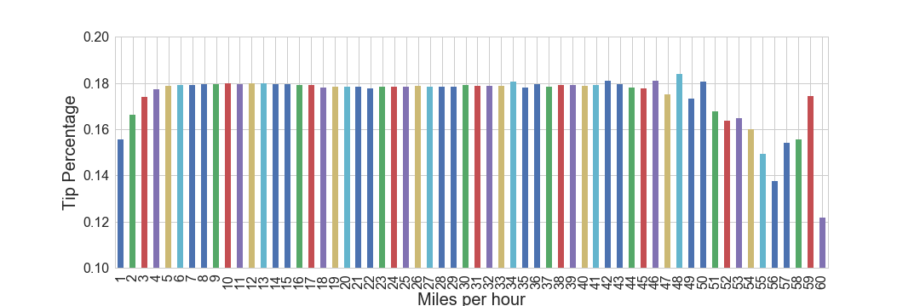
Tipping Behaviour

Slide 46
Tipping Behaviour

Slide 47
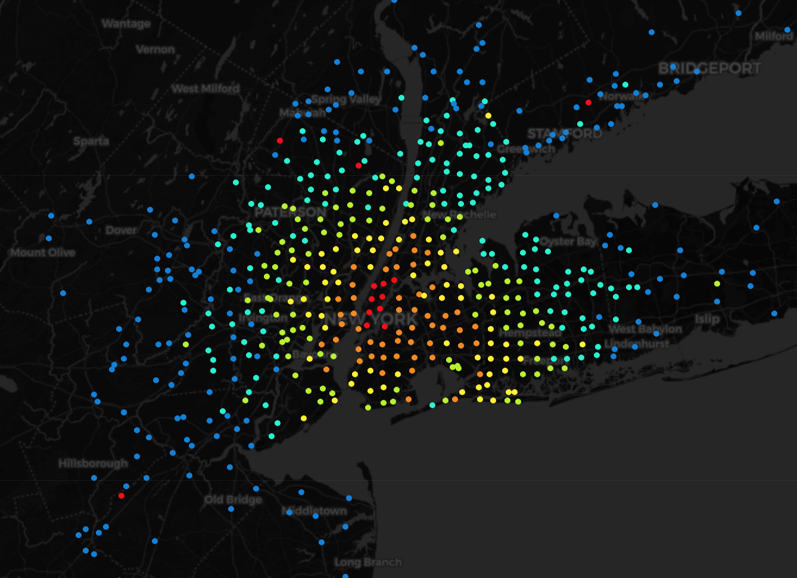
Distance by Dropoff Location
> 30 miles
> 20 miles
> 15 miles
> 10 miles > 5 Miles < 5 Miles

Slide 48
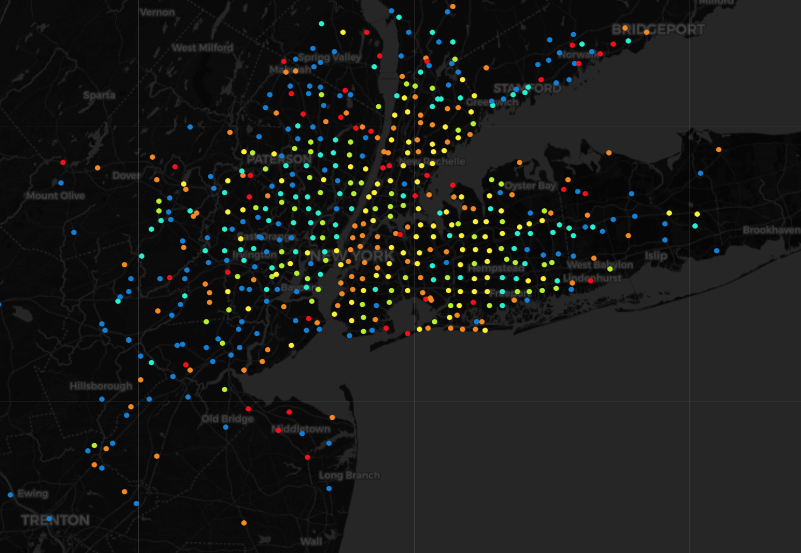
Tip Percentage by Dropoff Location
Tip Percentage
< 10 %
> 10 %
> 12.5%
> 15% > 17.5% > 20 %

Slide 49
Model Comparison – Tipping (MAE)

Slide 50
Model Comparison – Tipping (MAE)

Slide 51
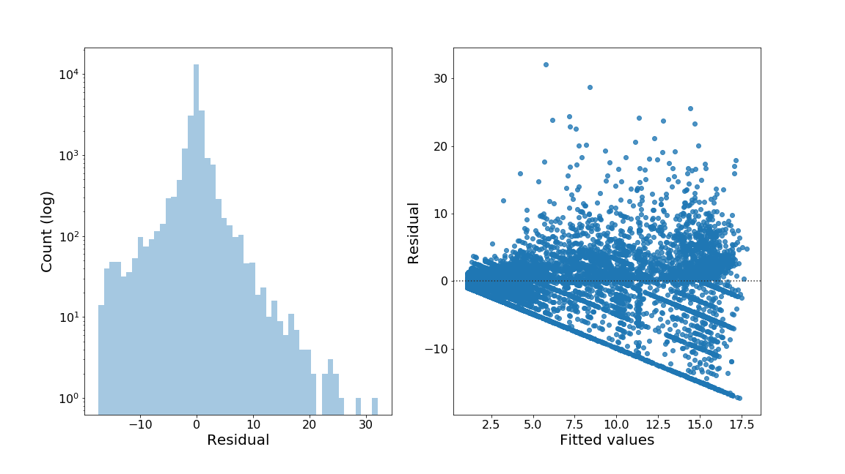
Tip Prediction - Evaluation

Slide 52
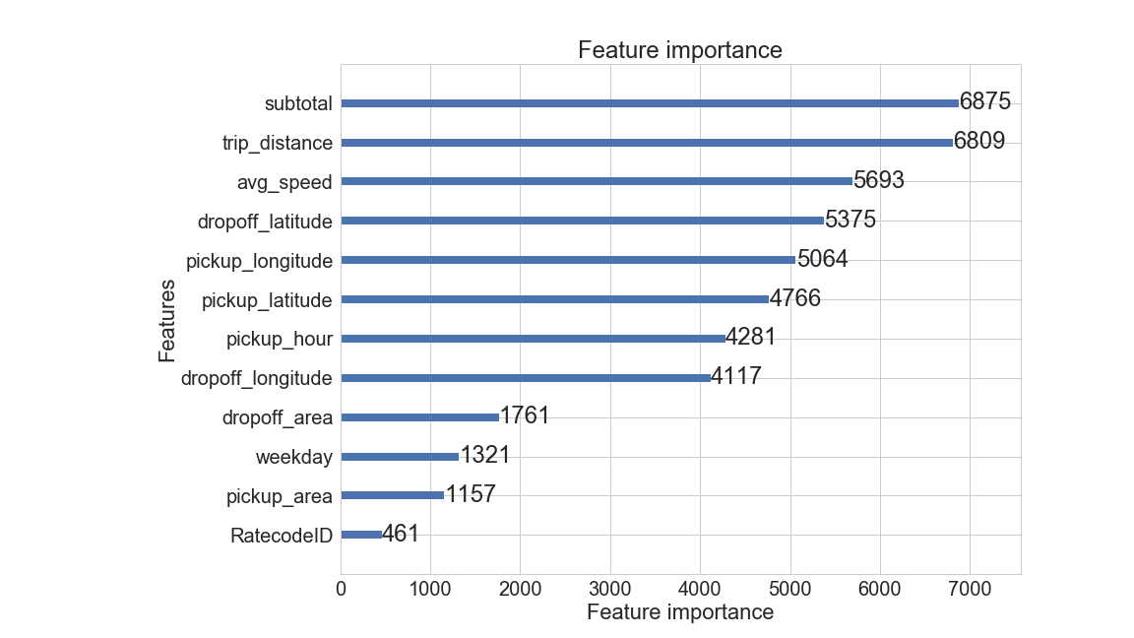
Tip Prediction - Evaluation

Slide 53
Evaluation
In Anhang: Resid plots und Err-Hist plot für jedes Modell

Slide 54
Retrospective
Use districts via geolocation shapefiles
For tip prediction
For MTA tax calculation
Outlier detection
Use googlemaps routes
External data?
Traffic data
Weather data
More knowledge about LightGBM

Slide 55
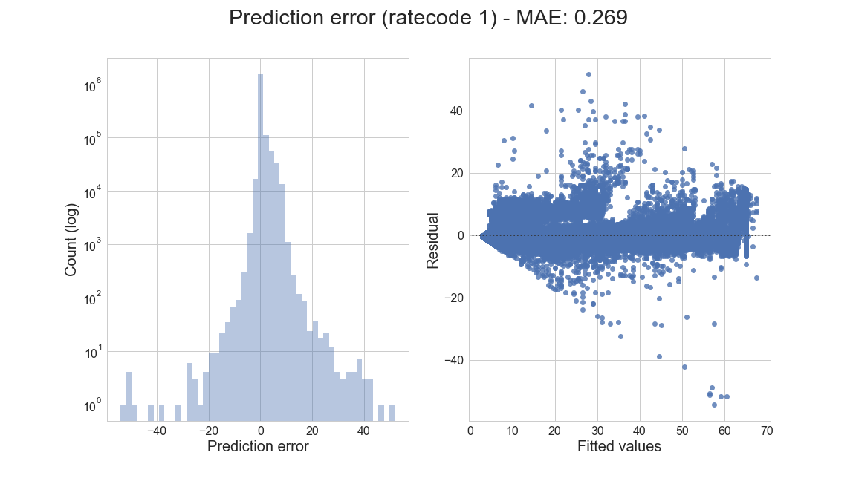
Ratecode 1 model evaluation

Slide 56
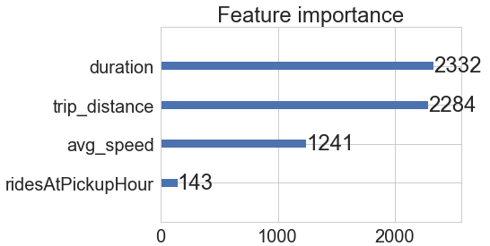
Ratecode 1 model evaluation

Slide 57
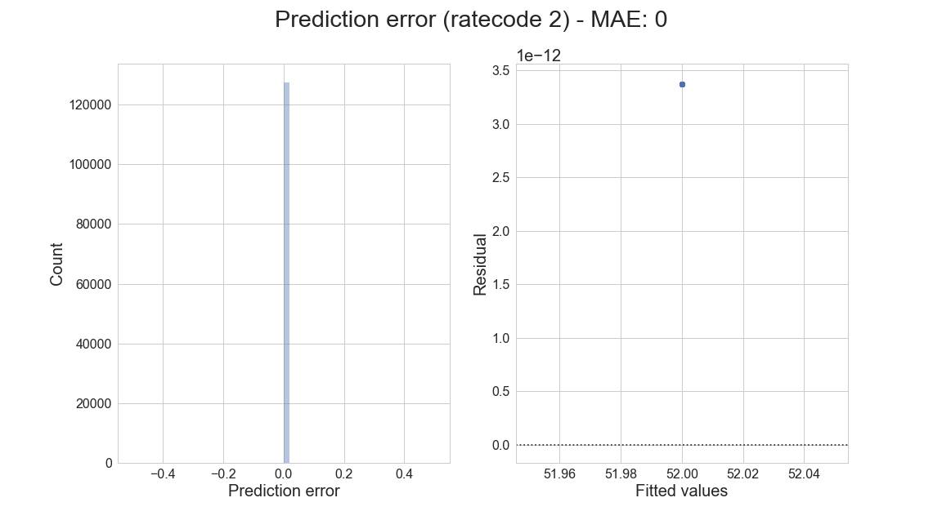
Ratecode 2 model evaluation

Slide 58
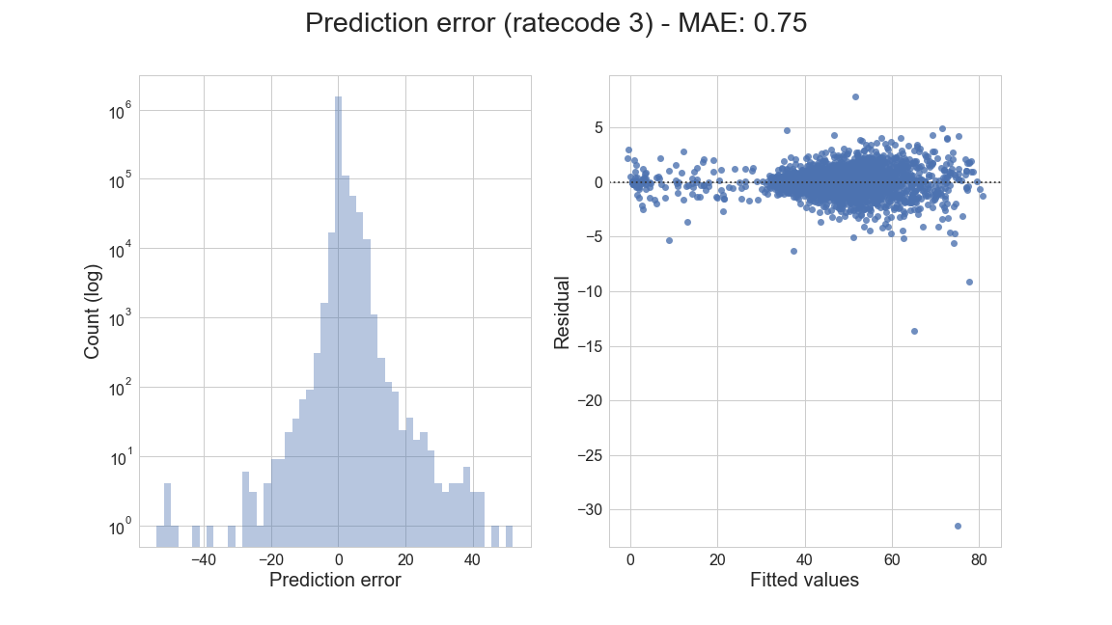
Ratecode 3 model evaluation

Slide 59
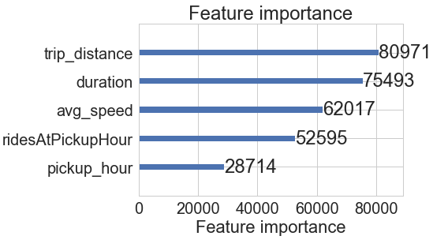
Ratecode 3 model evaluation

Slide 60
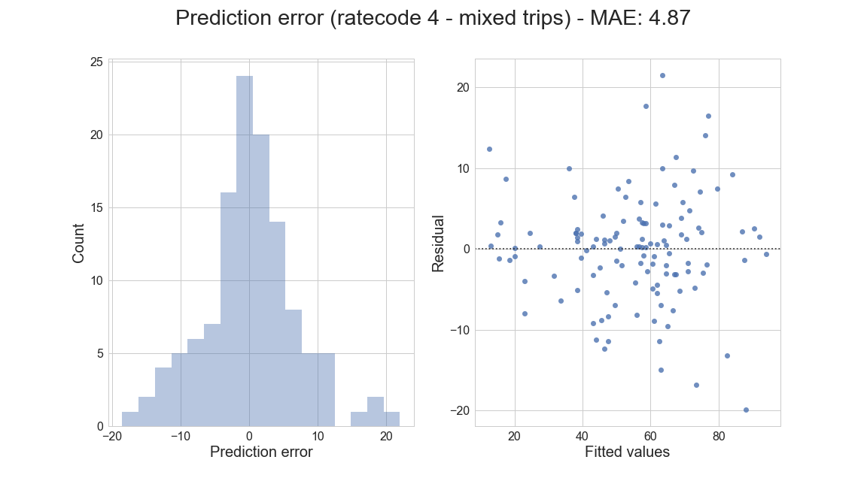
Ratecode 4 model evaluation

Slide 61
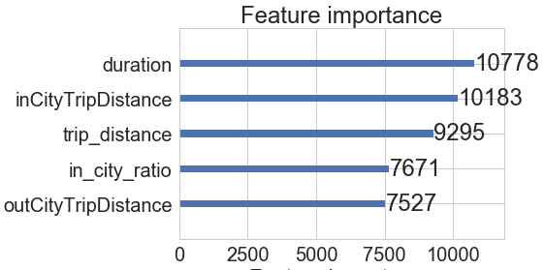
Ratecode 4 model evaluation

Slide 62
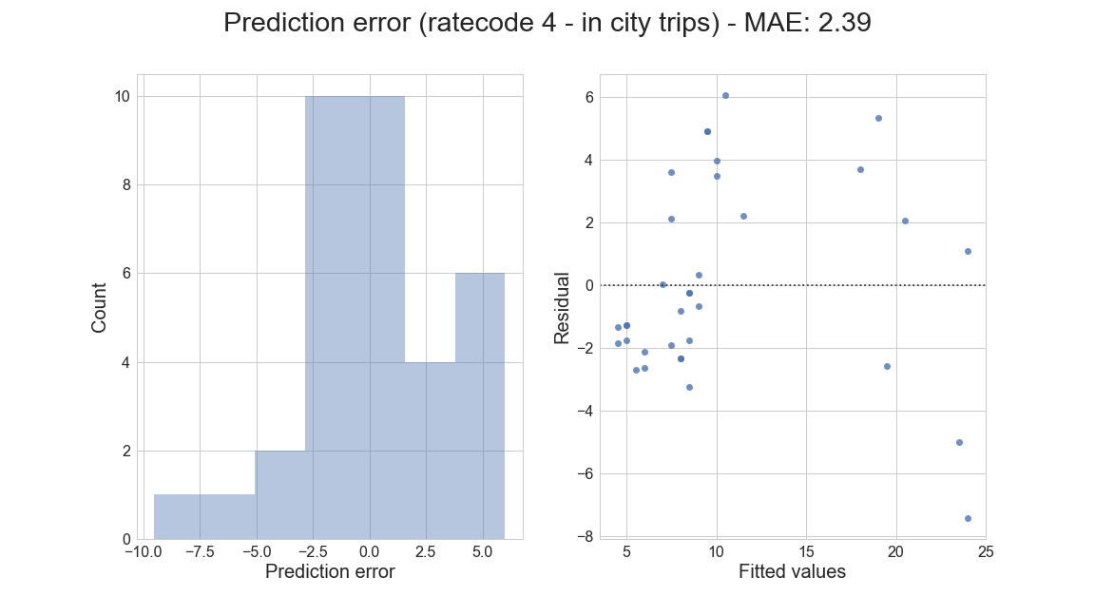
Ratecode 4 model evaluation

Slide 63
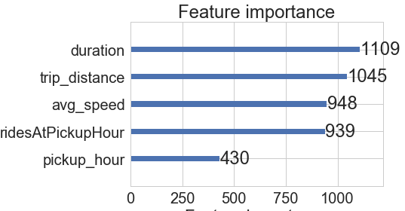
Ratecode 4 model evaluation

Slide 64
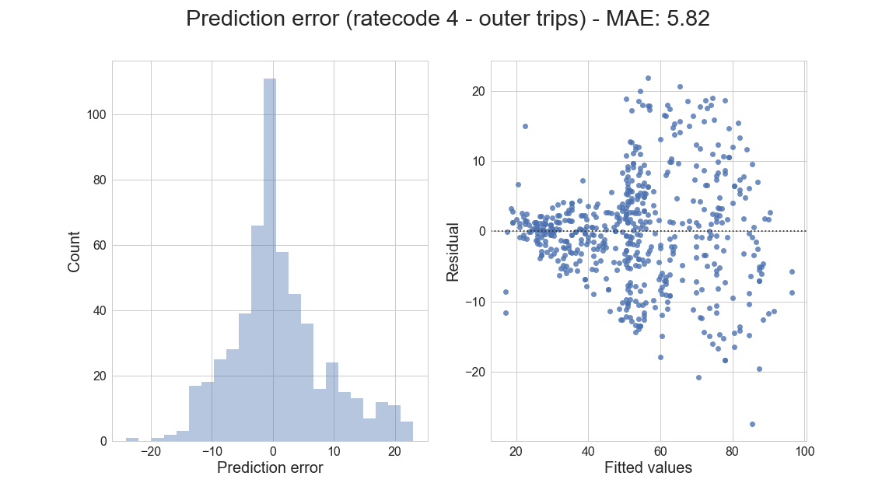
Ratecode 4 model evaluation

Slide 65
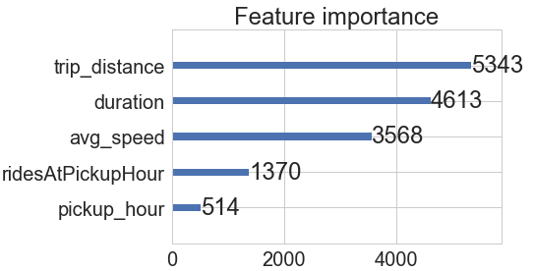
Ratecode 4 model evaluation

Slide 66
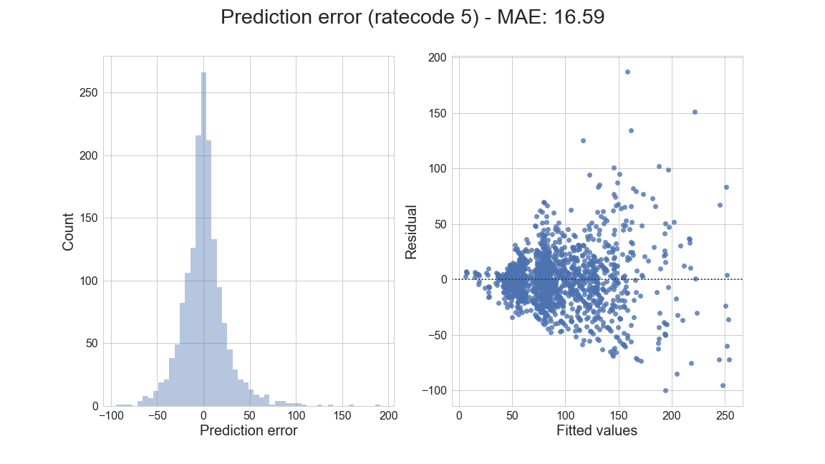
Ratecode 5 model evaluation

Slide 67
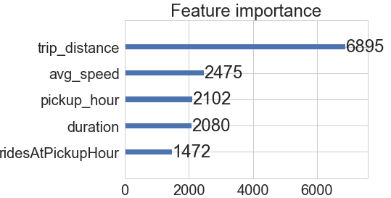
Ratecode 5 model evaluation

Slide 68
Extra Prediction
No Extra
Overnight
Rush Hour

Slide 69
Extra Prediction
No Extra
Overnight
Rush Hour

Slide 70
Extra amount by Dropoff time (2)

Slide 71
Tipping Behaviour

Slide 72
Tip Prediction - Features
Used
Longitude/Latitude
Subtotal
Average Speed
Weekday
Pickup time
Trip Distance
Tried
Pickup/Dropoff Area
Passenger count
Overnight
Rush hour

Slide 73
Tipping Behaviour

Slide 74
LGBM - Individual Models (MAE)

